Slide 1
Unique Aspects of Accounting for Not-for-Profit Organizations
November 17, 2022
Wenchen Wang

Slide 2
Non-for-Profit Organizations
Not-for-Profit Organizations
Have missions that differ substantially from for-profit organizations:
Receive contributions from individuals who do not expect an equal return
Have goals other than providing goods and services for profit
Have an absence of ownership interest.
Notes:
Chapters 9 and 10 provide an introduction to financial accounting.
The general principles of accounting are broadly applied to all types of organizations including for profit and not-for-profit org. Not-for-profit organizations generally have missions that differ substantially from those of for-profit organizations, and thus it should not be surprising that special reporting rules exist.
One of the common characteristics across not-for-profit organizations is the nondistribution constraint. This prohibits the organization from distributing its net income or profits to those who control the organization, such as the board of directors or the Executive Director.

Slide 3
Financial Statements
Financial Statements
Follow the Generally Accepted Accounting Principles (GAAP)
Issued by the Financial Accounting Standard Board (FASB)
GAAP provide guidance
Relevance
Understanding
Comparability
Notes:
Generally Accepted Accounting Principles (GAAP) for all nongovernmental organizations are developed through a series of statements issued by the Financial Accounting Standards Board (FASB).
The intent of special GAAP for not-for-profit organizations is to provide guidance to “enhance the relevance, understandability, and comparability of financial statements issued by those organizations.”2

Slide 4
Financial Statements
Financial Statements
Statement of financial position
Activity statement
Statement of cash flows
Independent Auditor’s Report
Notes to the financial statements
Notes:
All not-for-profit organizations must include a statement of financial position (balance sheet), statement of activities (operating or income statement), statement of cash flows, and notes that accompany the statements, whenever they present a set of audited financial statements.
Financial statements should always provide useful, relevant information to individuals outside the organization, such as creditors and vendors; not-for-profit financial statements have the additional purpose of providing adequate information to donors. Thus, although the basic statements are very similar, their presentation has some significant differences.

Slide 5
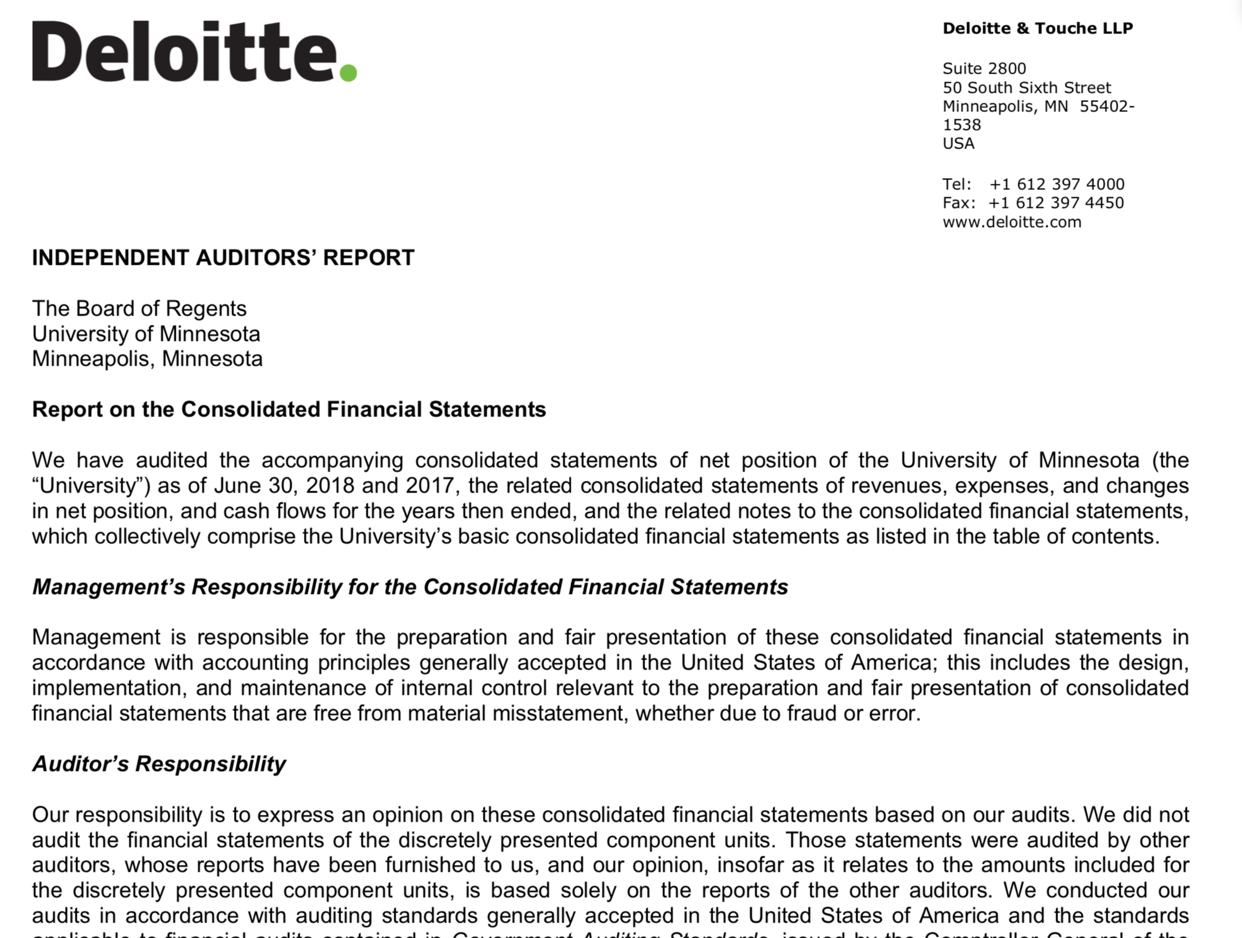

Slide 6
Statements of Financial Position
Statements of Financial Position
Are not required to segregate assets and liabilities into current and long-term
Must segregate assets that are subject to donor-imposed restrictions
Net Assets must be divided into: Unrestricted, temporarily restricted, and permanently restricted.
Notes:
The statement of financial position, or balance sheet, first examined in Chapter 9, provides information about the financial position of the organization at a moment in time. Included in the statement is information about liquidity and the organization’s ability to meet its obligations.
Not-for-profit organizations are not required to segregate assets into current and long-term or fixed assets on the balance sheet. However, at a minimum, either assets should be shown in order of decreasing liquidity (the most liquid assets listed first) or there must be disclosure of relative liquidity in the notes that accompany the financial statements. GAAP also requires not-for-profits to detail in the notes that accompany the financial statements, the availability of financial assets, detailing these assets’ nature, external limits (from donors, laws, or contracts), and internal limits (from the board). Furthermore, GAAP also requires disclosures on maintaining resources in accordance with donor intent, the not-for-profit’s goals for maintaining financial assets, policies related to investing excess cash, policies about spending board designated endowments, contracts that result in financial assets being unavailable for consumption, and information on lines of credit available.
In general, current assets may be combined on the balance sheet of the not-for-profit organization regardless of donor restrictions. Cash for general purposes and cash for current restricted purposes may be reported as one total number on the balance sheet. However, it is important not to give the impression that resources are available for uses for which they are not available. Therefore, if donors have placed restrictions on assets that prevent their use for current operations, they may not be commingled (mixed together) with current assets on the financial statements. The key to when assets may be commingled on the balance sheet is their availability for use for current operations. If restricted assets may be used for the coming year’s routine activities, they are commingled on the balance sheet. Otherwise they may not be commingled.
Restrictions on the use of assets have an impact on the net assets section of the balance sheet as well. The net assets section of the balance sheet must show two distinct classes of net assets: without donor restrictions and with donor restrictions (see Exhibit 11-1). Net assets with donor restrictions arise from gifts to endowments (which are restricted in perpetuity), or gifts restricted to specific programs or time of use.

Slide 7
As of December 31, 2017
Statement of Financial Position
ASSETS |  |  | LIABILITIES AND NET ASSETS
Cash | $ 100 |  | LIABILITIES
Marketable Securities | 3,000 |  | Wages Payable | $ 2,000
Accounts Receivable, Net of estimated uncollectable of $8,000 | 55,000 |  | Accounts Payable | 2,000
Inventory (LIFO basis) | 2,000 |  | Notes Payable | 6,000
Prepaid Expenses | 1,000 |  | Mortgages Payable | 16,000
Property | 40,000 |  | Total Liabilities | $26,000
Cash Restricted for Building Acquisition | 900
Equipment, Net | 35,000 |  | NET ASSETS
Investments | 8,000 |  | Unrestricted | $84,100
 |  |  | Temporarily Restricted | 4,900
 |  |  | Permanently Restricted | 30,000
 |  |  | Total Net Assets | $119,000
Total Assets | $145,000 |  | Liabilities and Net Assets | $145,000
Notes:
Exhibit 11-1 presents assets as one group, with the most liquid assets listed first.
A close examination of Exhibit 11-1 informs the user that in the case of Meals for the Homeless (Meals), the organization has $1,000 of cash. However, it is readily apparent from the balance sheet that only $100 of that cash can be used in the coming year.
Exhibit 11-1 we see that Meals has $34,900 of net assets with donor restrictions, and there is a reference in the exhibit to Note 4. This note would accompany the statement and would provide additional information about the nature of the restrictions. That $34,900 might be part of the land the organization owns, and it is possible that there are restrictions preventing the organization from ever selling the land. Alternatively, part of the $34,900 might be investments that earn an annual return; and that annual return is used to subsidize the cost of providing meals.
The assets associated with the donor-restricted net assets cannot be identified directly on the balance sheet. There is $900 of cash restricted for building acquisition. Those are clearly donor-restricted assets specified to a purpose. The remaining donor-restricted net assets may be included in equipment, investments, or property, and these asset accounts may reflect comingled assets with and without donor restrictions. In other words, except for the portion of donor-restricted assets that cannot be used for operating activities in the coming year, the donor-restricted assets are commingled with the assets without donor restrictions and cannot be specifically identified on the balance sheet. Organizations often keep track of donor-restricted assets separately.

Slide 8
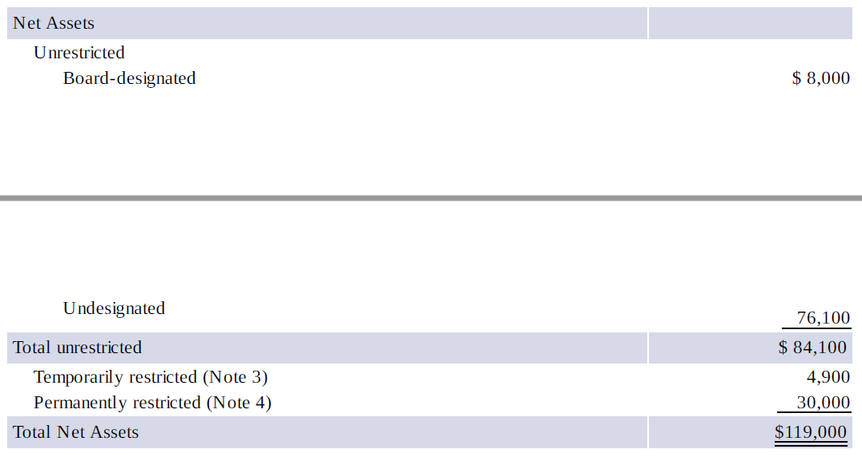
As of December 31, 2017
Cash Flow Statements
Notes:
Only donor-imposed restrictions create net assets that are restricted permanently or temporarily (for purpose or time). Self-imposed restrictions (often arise when the board of trustees or directors decides that money should be segregated and saved for a future purpose, such as building replacement) would create a subtotal within the net assets without donor restrictions category but with board designated category
Note that the designation has not changed the net assets with donor restrictions. Total net assets are also unchanged (see Exhibit 11-1). The only impact of the board designation is on the presentation of the net assets without donor restrictions within the Net Assets section of the balance sheet.

Slide 9
Statement of Activities
Statement of Activities
Revenues and support: Shown as increases in unrestricted net assets unless there are donor-imposed restrictions on the use.
Expenses: Reported as decreases in unrestricted net assets.
Expenses must be reported separately from revenues.
Netting is generally not permitted.
Gains and Losses on Investments: Shown as changes in unrestricted net assets unless specific donor-imposed restrictions prohibit their use.
As donor restrictions expire, donations become unrestricted support.
Notes:
The statement of activities (activity statement) reports the results of operations over a period as well as some other events that affect the net assets of the organization. It encompasses the information in an income or operating statement but goes farther in reporting other changes in net assets. The statement can help users understand how well the organization has done, how viable it is, and how effective its managers are.
The statement includes revenues, expenses, gains, and losses, just as the income statement would for most for-profit organizations. It also includes other changes to net assets, such as those resulting from changes to accounting standards that adjust existing accounts on the balance sheet.
Revenues are shown as increases in net assets without donor restrictions, except when there are donor-imposed restrictions on the use of the assets received.
Expenses are reported as decreases in net assets without donor restrictions. Contributions are considered to be revenues or gains and are categorized as a change in either net assets with or without donor restrictions depending on whether there are donor-imposed restrictions on their use.
Gains and losses on investments and other assets are shown as changes in net assets without donor restrictions unless there are donor-imposed or legal restrictions.
In any financial report presented to users outside the organization, there is a balance to be achieved in the amount of disclosure. The organization does not want some outsiders, such as competitors, to know too much about its operations. Therefore, there is a tendency to try to restrict the amount of information provided. To prevent too much restriction, GAAP require that revenues be reported separately from expenses. That is, one cannot simply provide a net figure of the difference between revenues and expenses. Both revenue information and expense information must be provided. However, some netting out is allowed and even mandated. For example, investment revenues must be reported net of investment expenses, such as stockbrokers’ commissions, on the activity statement.

Slide 10
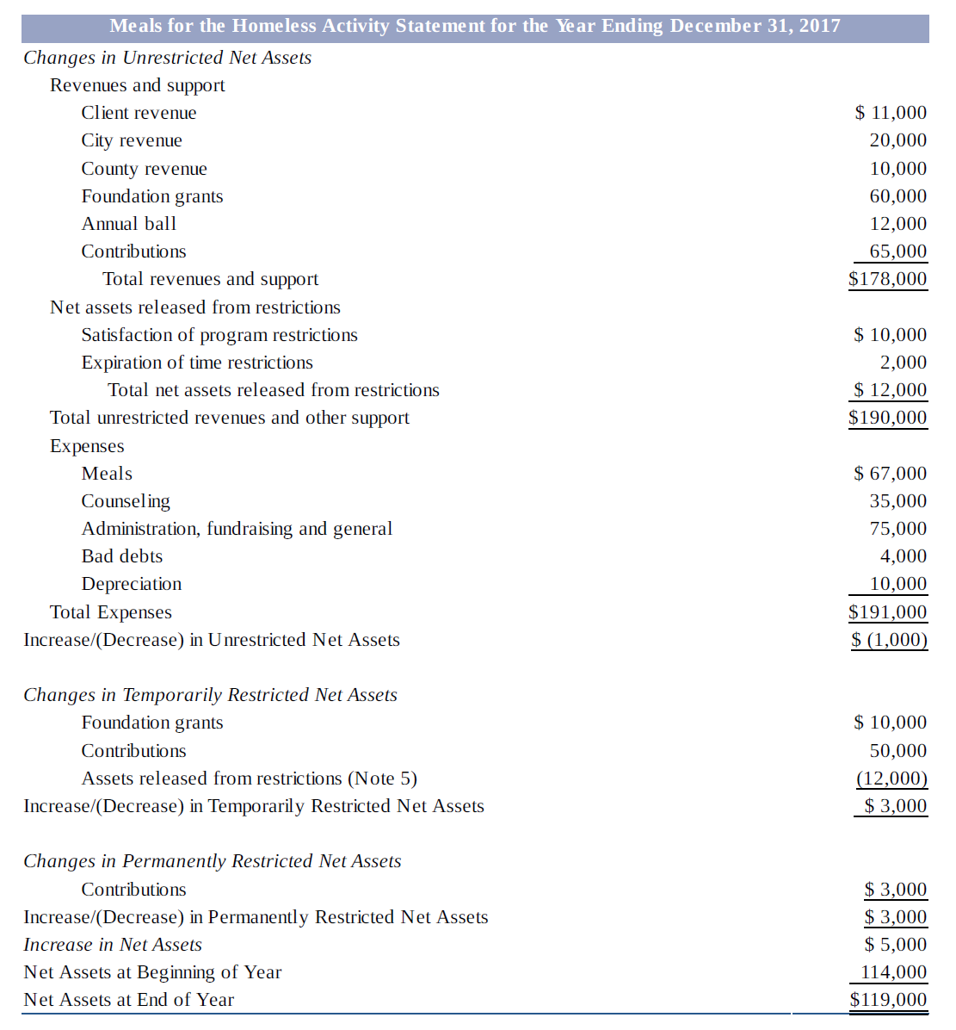
Statement of Activities
Statement of Activities
Notes:
Not-for-profit organizations have to use a presentation for the activity statement that clearly identifies changes in each category of net assets. In Exhibit 11-2 changes that affect net assets without donor restrictions are shown first, followed by changes in net assets with donor restrictions.
The first section of Exhibit 11-2 shows the changes in net assets without donor restrictions. This includes all revenue and support that does not have a donor restriction attached to it. In the case of Meals, this includes client revenue, city revenue, county revenue, foundation grants, the annual ball, and contributions. It also includes net assets that have been released from restrictions. Some donations had restrictions limiting their use for specific purposes (program restrictions), and some were limited as to when they could be used (time restrictions). In Exhibit 11-2 we see that net assets without donor restrictions increased by $12,000 as a result of the release from restrictions. The first section of the activity statement also includes expenses, because expenses are all treated as decreases in net assets without donor restrictions.
The next section of Exhibit 11-2 is changes in net assets with donor restrictions. For Meals, this section includes both increases from foundation grants and donations that have restrictions and decreases as restrictions are met and the donations are released. Note that the $12,000 decrease in this section exactly offsets the $12,000 increase in the earlier section of the statement. Effectively, net assets have not changed as a result of this reclassification from with donor restrictions to without donor restrictions. Total net assets increase when a donor-restricted contribution or grant is first received. Notice that the $10,000 foundation grants and the $50,000 in contributions in this section do increase total net assets. Both categories are then totaled and added to beginning net assets to determine net assets at the end of the year.

Slide 11
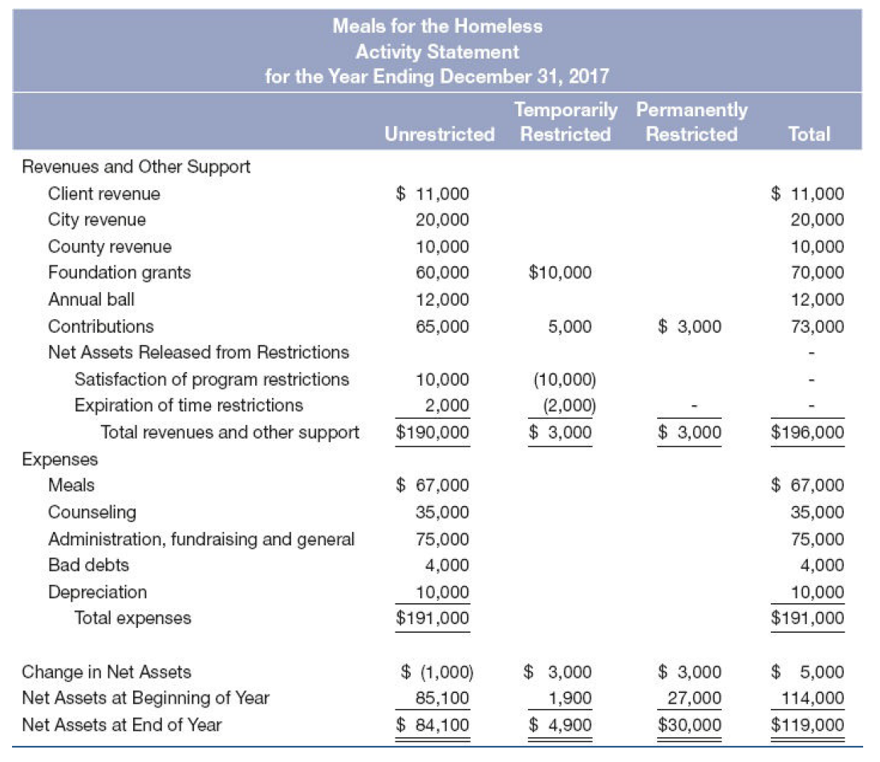
Statement of Activities
Statement of Activities
Notes:
In Exhibit 11-3 separate columns are used for net assets with and without donor restrictions.
The activity statement is meant to capture all changes in net assets. It shows the change in net assets for both net asset classes. All increases or decreases in donor-restricted net assets must be shown.

Slide 12
Statement of Functional Expenses
Statement of Functional Expenses
Expenses presented by function and nature
Major program services and supporting activities
Salaries, rent, depreciation
Expenses must be presented either in the activity statement or the notes for all NFP organizations.
→ Insight into the operations of an organization
Notes:
Not only must expenses be shown separately from revenues, but also expenses must be shown in some amount of detail. This provides donors and other outsiders with a sense of where the organization’s money is going. Specifically, expenses must be disclosed in one location (in the activity statement, in the notes as a separate schedule, or in a separate financial statement) by their functional class. Such disclosure provides information on expenses for major program services and supporting activities. All not-for-profits must report information not only by functional class, but also by natural classification such as salaries, rent, depreciation, and so on.

Slide 13
Statement of Functional Expenses
Function
 | Program Services |  | Support Services |  | Total
Expenses | Meals | Counseling | G&A | Fundraising
Salaries and Benefits | $35,000 | $35,000 | $40,000 | $17,000 | $127,000
Food | $17,000 |  |  |  | $17,000
Supplies and Brochures | $2,000 | $1,000 | $1,000 | $2,000 | $6,000
Office Expenses | $1,000 | $1,000 | $1,000 | $3,000 | $6,000
Rent | $14,000 | $1,000 | $2,000 | $1,000 | $18,000
Professional fees |  |  | $3,000 |  | $3,000
Bad Debts | $4,000 |  |  |  | $4,000
Depreciation | $10,000 |  |  |  | $10,000
Total Expenses | $83,000 | $38,000 | $47,000 | $23,000 | $191,000
Nature
Why is it important to separate support services from program services?
Notes:
Traditionally, this analysis is displayed by most not-for-profit organizations in a matrix format showing expenses by function and by nature (or expense object; e.g., salary, fringe, supplies). That matrix format is called a statement of functional expenses, as seen in here.
Notice that expenses are divided between program services and support services. Program services are the direct areas that result in providing services (or goods) that achieve the organization’s mission. For example, providing meals is one program area for Meals. Providing counseling services is another. The administration of the organization and the fundraising activities, however, are support services. Not-for-profits are also required to disclose a description of the methods used to allocate costs among program and support categories (Refer back to cost allocation methods we have talked about in class).
Why would the financial statements need to provide information on program services separately from support services? The public is often concerned, rightly or wrongly, that not-for-profits spend too much on administrative activities and too little on providing services. There have been instances in which some organizations spent a substantial share of their total resources on fundraising, more than many believe appropriate. By reporting program activities separately, financial statement users can quickly determine the share of the resources that are actually used in providing services.

Slide 14
Statement of Cash Flows
Statement of Cash Flows
NPOs required to provide a statement of cash flows.
Necessary to distinguish between cash available for current operations versus cash that is unavailable in the near term.
Can use the direct or indirect method
Must show the three sections (operating, financing, and investing) regardless of method used.
Notes:
Not-for-profit organizations are required to provide a statement of cash flows. However, it is necessary to distinguish between cash that has been received and is available for current operations (i.e., resources without donor restrictions) versus cash that is donor-restricted and unavailable in the near term.

